Slide 1

Superstore Sales Analysis

Slide 2
problem statement
The Superstore dataset provides sales data for a variety of products across different categories and regions.
The goal of this project is to analyze the data and identify insights that can help the company improve its business performance.
Specifically, we aim to answer questions such as: which product categories are the most profitable? Which regions have the highest sales and profit? What are the most profitable products? By answering these questions, we hope to provide recommendations for the company on how to optimize its product offerings and improve its revenue and profitability.

Slide 3
Gather and clean the data
After defining the core problem, we collect relevant information required for analysis.
This can entail accessing pre-existing data sets or gathering information from many sources.
To make sure the data is correct, comprehensive, and consistent, cleaning it is imperative.

Slide 4
Explore the data
Exploration is very important, for efficient analysis we familiarize ourselves with the structure of data.
There are many exploratory analysis techniques.

Slide 5
assumptions
A sample of all transactions made by the store throughout the time period covered by the dataset is included in the superstore dataset.
.
A sample of all transactions made by the store throughout the time period covered by the dataset is included in the superstore dataset.
The length of the superstore dataset makes it possible to spot trends or patterns in sales and profitability.
There are no notable outliers or abnormalities affecting the Super Store dataset that might distort the findings of any study done on the data.

Slide 6
research questions
We are curious as to what elements of the superstore's excellent sales are attributed to.
Which Super Store product categories have the biggest profit margins?
Do the East region's sales differ significantly from those of other areas?
What seasonal variations exist in product category sales over the course of the year? When compared to alternative delivery choices, what is the rate of product returns for orders shipped the same day? What differences exist between weekdays and weekends in terms of product category sales and profit?

Slide 7
hypotheses
1: When compared to other methods of payment, cash is the most popular.
2: In comparison to the other states, Naypyidaw has the greatest sales.
3: Sales are greater from customers that are members.
4: The business generates less money at the beginning of the year or first quarter.
5: Technology products generate more revenue compared to other products.

Slide 8
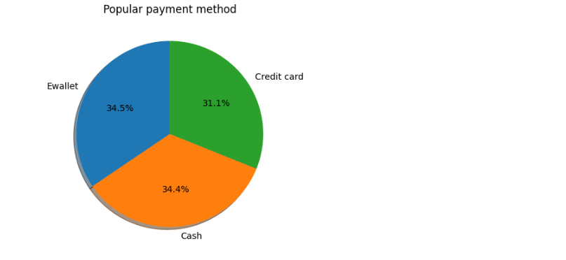
Hypothesis 1
First hypothesis: When compared to other methods of payment, cash is the most popular.
The data does not support this hypothesis. Analysis proved that Ewallet was the most preferred payment method for customers.

Slide 9
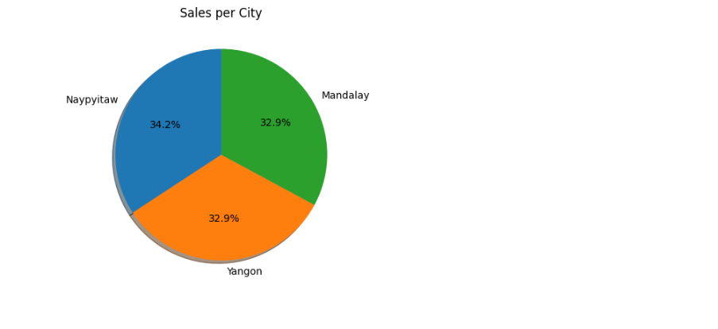
Hypothesis 2
Second hypothesis: In comparison to the other states, Naypyidaw has the greatest sales.
Findings from the data show that Naypyidaw does indeed have the greatest sales in comparison to the other states.

Slide 10
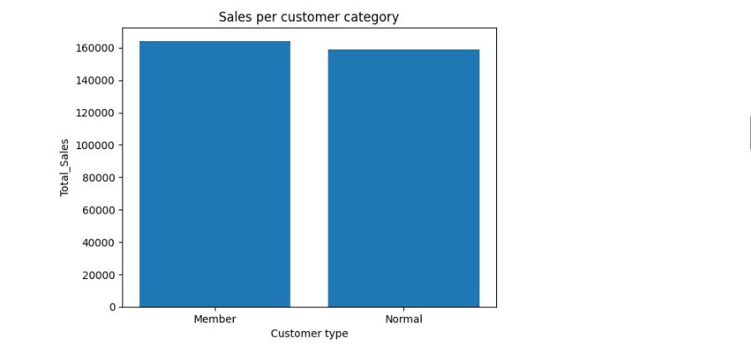
Hypothesis 3
Thirdly: Sales are greater for customers that are members
Data analysis supports this hypothesis, members have a sense of loyalty to the business and it reflects in terms of overall sales.

Slide 11
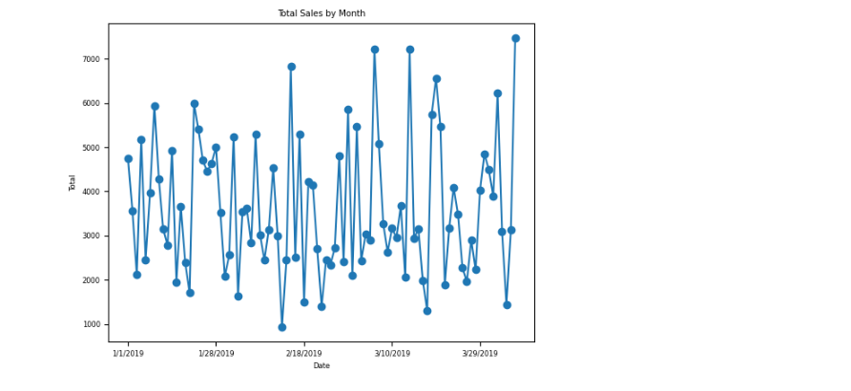
Hypothesis 4
Fourthly: The business generates less money at the beginning of the year or first quarter.
This hypothesis is true, analysis shows an increase in sales from the beginning of the quarter/year as the year progresses.

Slide 12
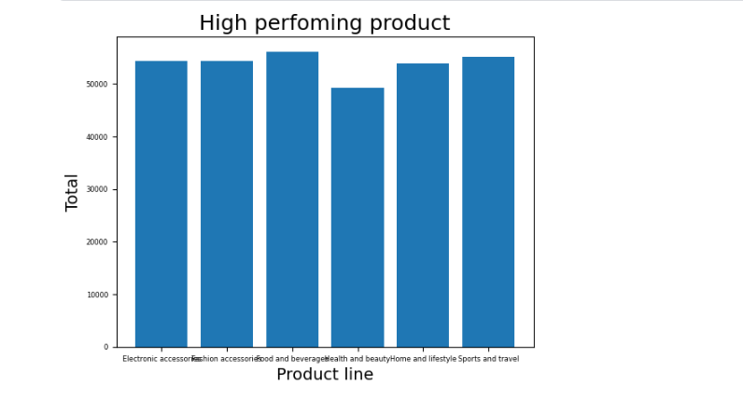
Hypothesis 5
Electronic products generate more revenue compared to other products.
This hypothesis has proven false. The food and beverages category generates more revenue for the business

Slide 13
Results conclusion
First Hypothesis- When compared to other methods of payment, cash is the most popular…
This theory is not supported by the evidence. Analysis demonstrated that consumers' preferred mode of payment was an e-wallet.
Second Hypothesis- In comparison to the other states, Naypyidaw has the greatest sales…
According to the data, Naypyidaw does, in fact, have the highest sales when compared to the other states.
Third Hypothesis- Sales are greater from customers that are members…
This theory is supported by data analysis; members' sense of loyalty to the company is reflected in total sales
Fourth Hypothesis- The business generates less money at the beginning of the year or first quarter…
The first quarter or start of the year saw lower revenue for the company
Fifth Hypothesis-Electronic products generate more revenue compared to other products…
In terms of revenue, the food and beverages products outperform all the other products.

Slide 14
recommendations
The business should keep accepting all available payment options. Although data indicates that Ewallet payments are the most favoured option, the study also indicates that cash payments are also very frequently used. Additionally, it is crucial to maintain the availability of all payment methods in the event of network, cash, or IT malfunctions.
Given that the Naypyidaw region has the largest sales in comparison to other locations, the corporation may choose to concentrate more of its efforts there. There after, the business has to review its sales and marketing plans for other areas.
The company could consider offering more benefits with the membership. This might include special tills for members who are buying in larger quantities, discounts on certain products & giving members a preview for upcoming sales and products.

Slide 15
Suggestions
The latter two quarters of the year are when the corporation should concentrate on increasing revenue. This could entail boosting the stock of well-liked items during this period, launching focused advertising efforts, and providing clients with special offers or discounts. But the business should also think about ways to keep sales going in other months, such as launching new goods or services or running specials and discounts in slower months.
To boost profitability, the corporation ought to concentrate on creating and marketing food and beverage goods. They could also think about marketing and producing fewer goods with smaller profit margins.

